Slide 1
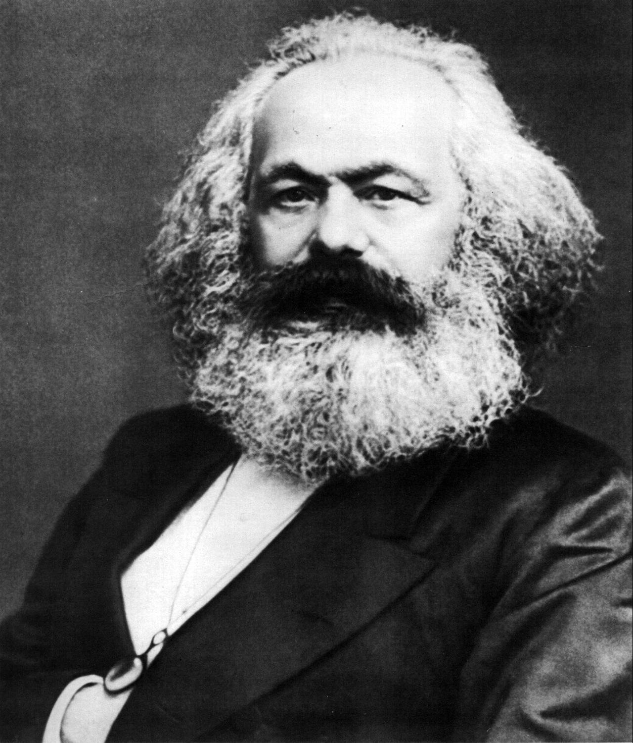
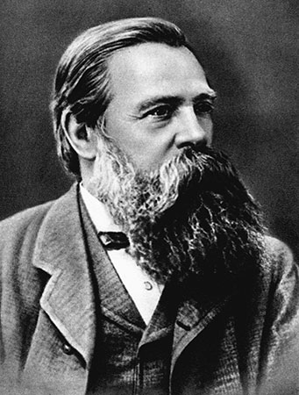
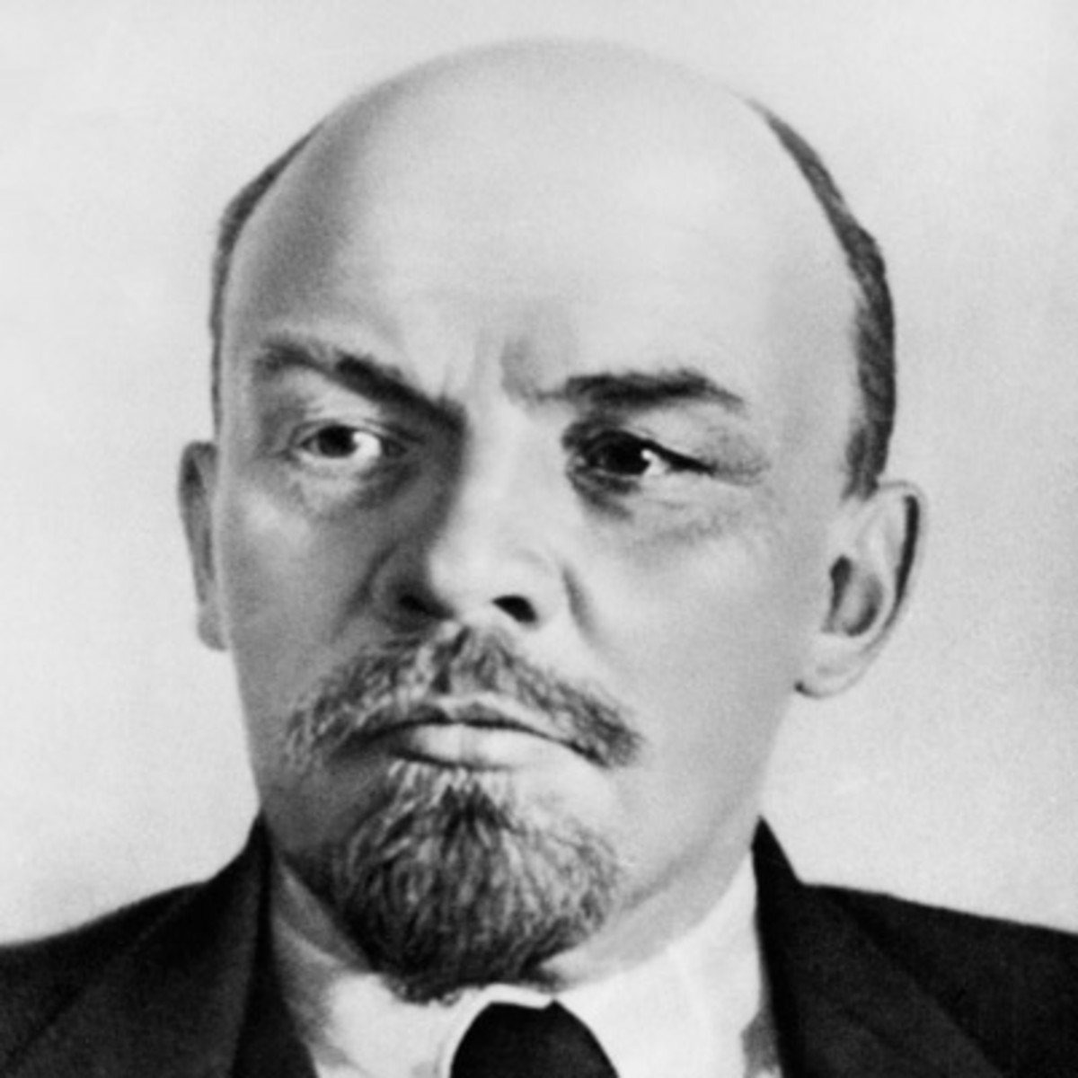
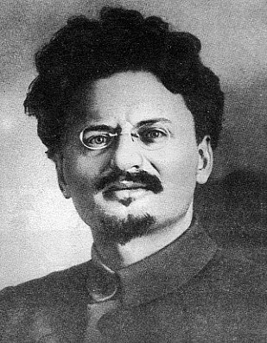
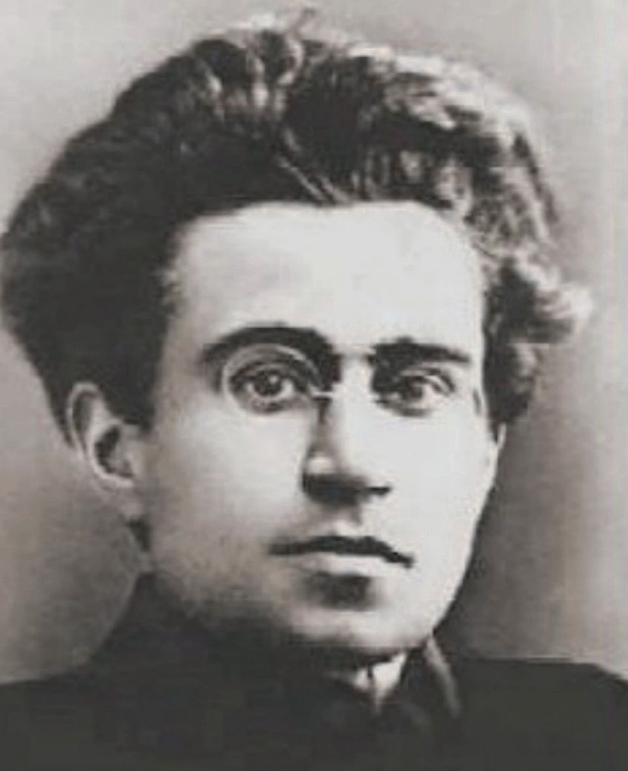
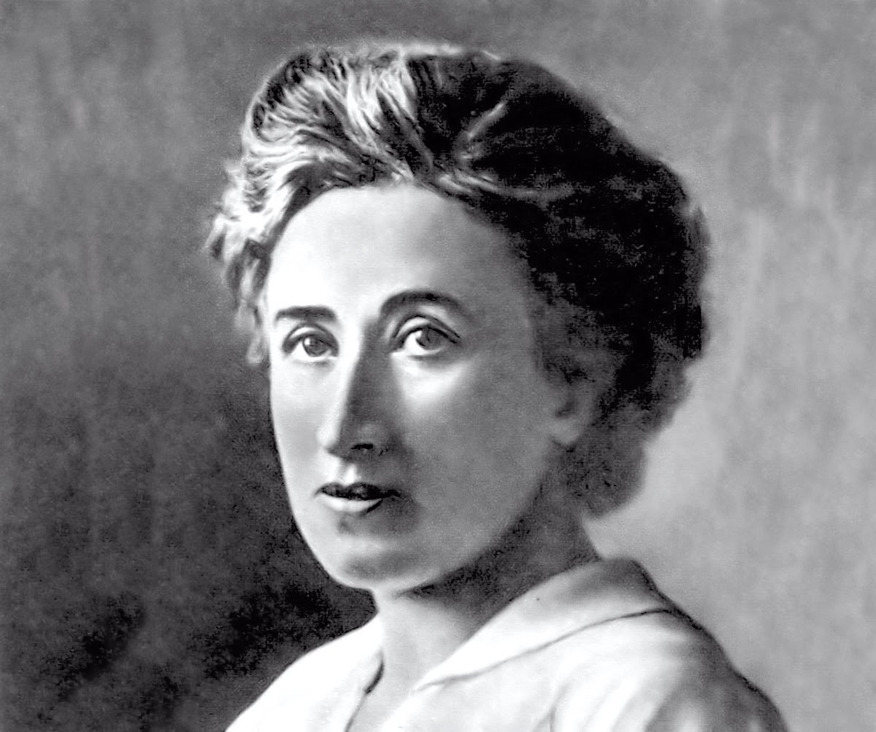
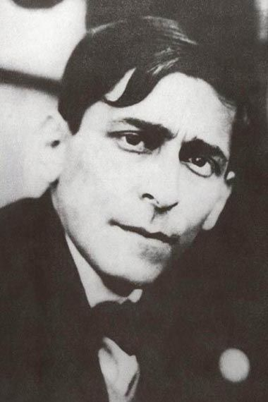
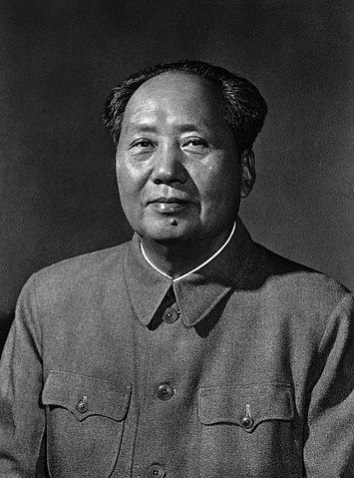
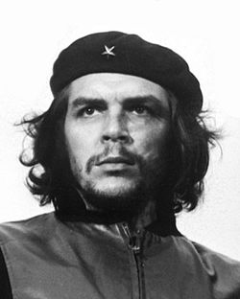
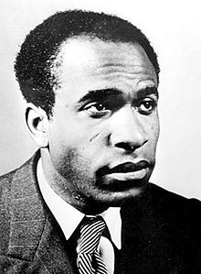
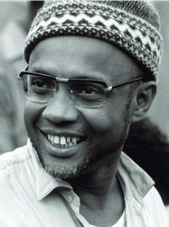
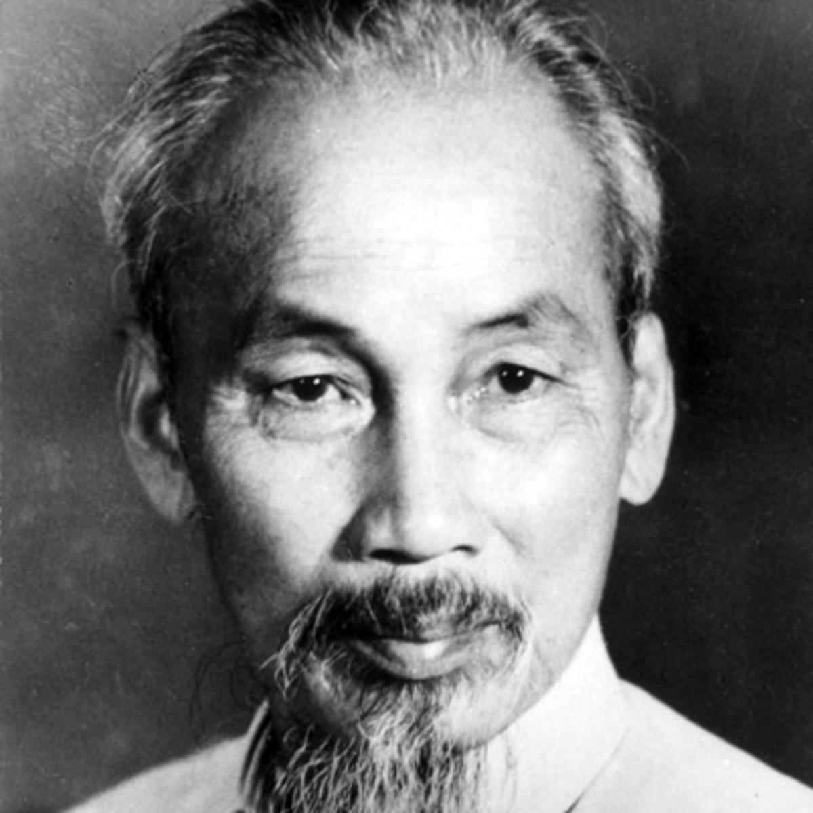
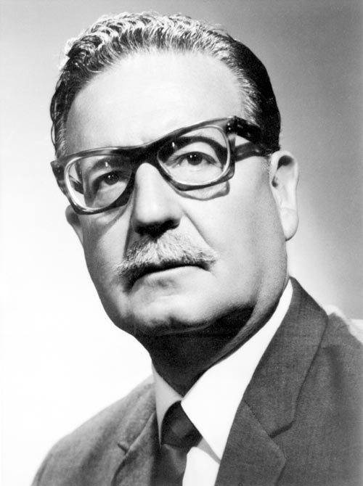
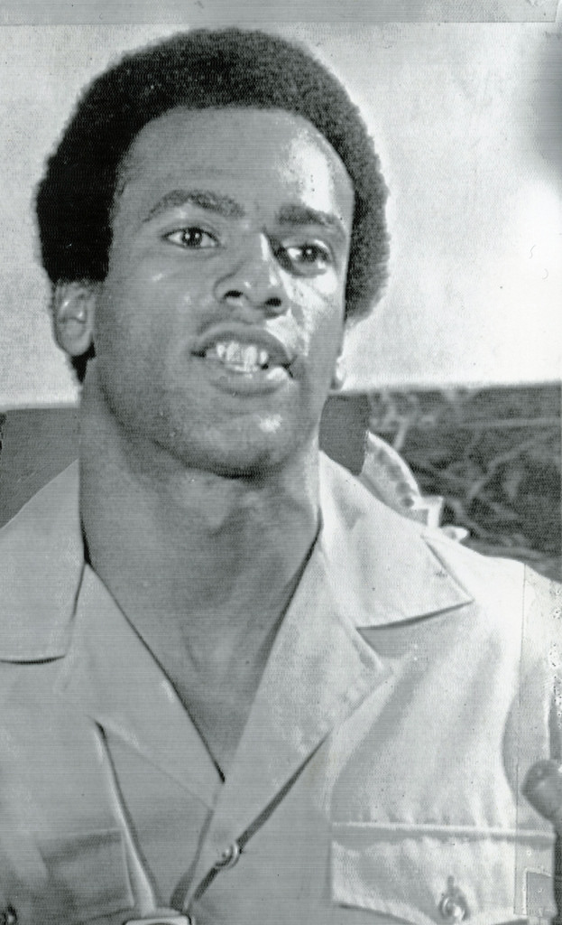
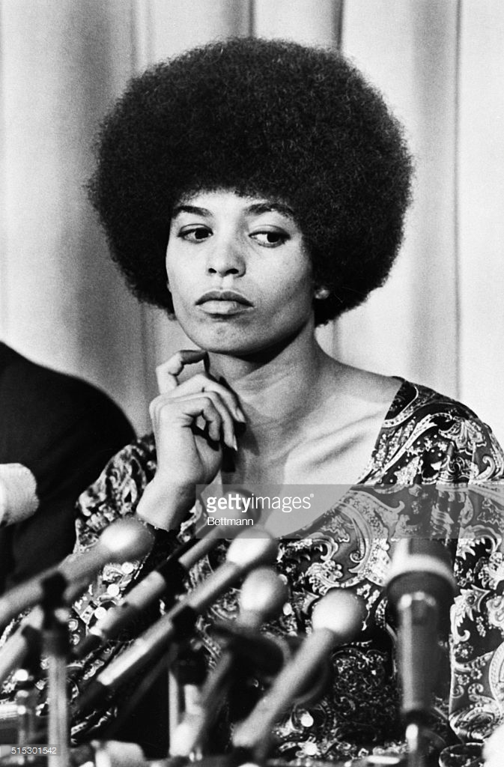
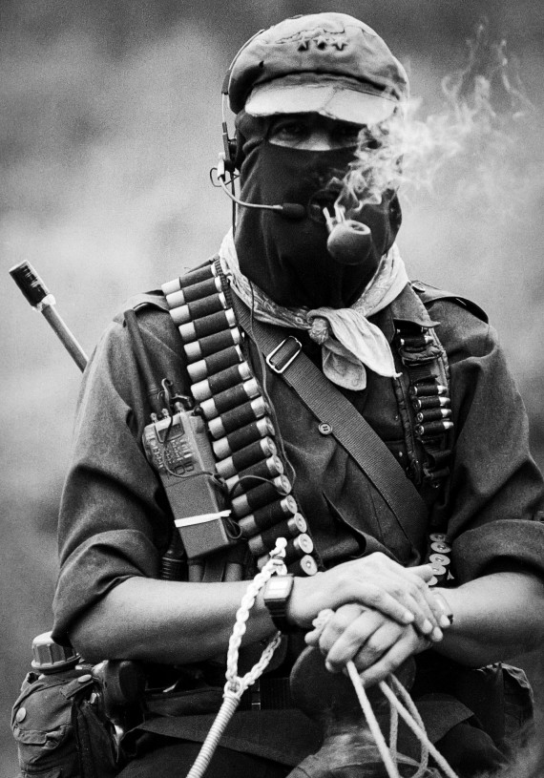
RADICAL SOCIAL THEORY AND REVOLUTIONARY PRACTICE IN THE TWENTIETH CENTURY
IN THIS COURSE WE WILL NOT READ ACADEMIC WORKS: EVERY READING - EXCEPT FIRST AND FINAL WEEK - BY THE LEADERS THEMSELVES OF 20TH CENTURY REVOLUTIONS
From left to right: Marx, Engels, Lenin, Trotsky, Gramsci, Luxemburg, Mariátegui,
Mao, Che, Fanon, Cabral, Ho Chi Minh, Salvador Allende, Huey Newton, Angela Davis, Sub-Comandante Marcos

Slide 2
WHAT IS A SOCIAL REVOLUTION?
COURSE ON SOCIALIST AND SOCIALIST-ORIENTED REVOLUTIONS AND REVOLUTIONARIES IN 20TH CENTURY
A FUNDAMENTAL CHANGE IN THE SOCIAL STRUCTURE OF A SOCIETY, BROUGHT ABOUT BY STRUGGLE AMONG OPPOSING SOCIAL AND CLASS FORCES AND THE UPRISING OF OPPRESSED GROUPS, USUALLY INVOLVING THE OVERTHROW OF THE RULING CLASS, THE RISE TO POWER OF NEW CLASSES AND SOCIAL GROUPS, AND A FUNDAMENTAL CHANGE IN PROPERTY (THAT IS, CLASS) RELATIONS.
POVERTY AND OPPRESSION NOT ENOUGH TO BRING ABOUT A REVOLUTIONARY REVOLUTIONARY, RATHER:
- INEQUALITY AND FRUSTRATED EXPECTATIONS;
- A SENSE THAT CHANGE IS POSSIBLE; A RUPTURE OF RULING CLASS HEGEMONY; A REVOLUTIONARY IDEOLOGY AND MOVEMENT;
- A CRISIS IN THE PREVAILING SYSTEM AND WITHIN THE RULING CLASSES
REVOLUTIONS ARE DRIVEN BY CONTRADICTIONS THAT CANNOT BE RESOLVED WITHIN THE SOCIAL ORDER, APPEAR DURING TIMES OF CRISIS, AND CONSTITUTE A DECISIVE MOMENT OF TRANSFORMATION [THE REAL CHALLENGE BEGINS AFTER THE REVOLUTIONARY TRIUMPH]
20TH CENTURY: ”AGE OF EXTREMES,” AGE OF REVOLUTIONS

Slide 3
CURRENT CRISIS OF GLOBAL CAPITALISM, RESURGENCE OF SOCIALIST IDEAS AND STRUGGLES ARE WE IN A PRE-REVOLUTIONARY SITUATION?
TO THE MARXISTS IT IS INDISPUTABLE THAT A REVOLUTION IS IMPOSSIBLE WITHOUT A REVOLUTIONARY SITUATION: FURTHERMORE, IT IS NOT EVERY REVOLUTIONARY SITUATION THAT LEADS TO REVOLUTION. WHAT, GENERALLY SPEAKING ARE THE SYMPTOMS OF A REVOLUTONARY SITUATION?
WHEN IT IS IMPOSSIBLE FOR THE RULING CLASSES TO MAINTAIN THEIR RULE WITHOUT ANY CHANGE; WHEN THERE IS A CRISIS AMONG THE “UPPER CLASSES,” LEADING TO A FISSURE THROUGH WHICH THE DISCONTENT AND INDIGNATION OF THE OPPRESSED CLASSES BURST FORTH; FOR A REVOLUTION TO TAKE PLACE, IT IS USUALLY INSUFFICENT FOR THE “LOWER CLASSES” NOT TO WANT TO LIVE IN THE OLD WAY; IT IS ALSO NECESSARY THAT THE UPPER CLASSES SHOULD BE UNABLE TO LIVE IN THE OLD WAY;
WHEN THE SUFFERING AND WANT OF THE OPPRESSED CLASSES HAVE GROWN MORE ACUTE THAN USUAL;
WHEN, AS A CONSEQUENCE OF THE ABOVE CAUSES, THERE IS A CONSIDERABLE INCREASE IN THE ACTIVITY OF THE MASSES, WHO UNCOMPLAININGLY ALLOW THEMSELVES TO BE ROBBED IN ‘PEACE TIME’, BUT IN TURBULENT TIMES, ARE DRAWN BOTH BY ALL THE CIRCUMSTANCES OF THE CRISIS AND BY THE UPPER CLASSES THEMSELVES INTO INDEPENDENT HISTORICAL ACTION.
THESE ARE “SYMPTOMS”, HOWEVER…. THERE IS ONE OTHER CONDITION MISSING…

Slide 4
Why Study 20th Century Revolutionary Theory and Practice?
We do not understand our past we cannot understand the present and nor can we shape the future
How do we assess 20th century revolutions, including their failures? NOTE: revolutions extremely complex, no “right way”
Don’t romanticize! We will study these revolutions and revolutionaries in all their limitations and contradictions.
What lessons can we draw for revolution in the 21st century? Many open-ended debates, no “right answers”
How is the past reflected in 21st social justice and revolutionary struggles? How has it informed these struggles?
Amilcar Cabral: “Tell No Lies. Mask no Difficulties, Mistakes, Failures. Claim no Easy Victories”
For those of us who consider ourselves intellectuals committed to the oppressed: studying revolutionary theory and practice is a part of that commitment

Slide 5
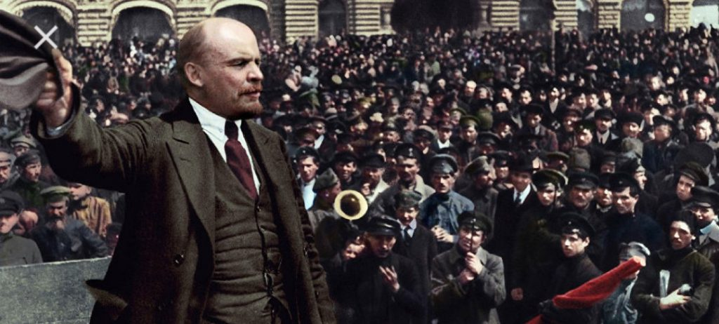
What Is The Missing Condition of which Lenin Spoke?
“THE TOTALITY OF THESE OBJECTIVE CHANGES IS CALLED A REVOLUTIONARY SITUATION. [SUCH A SITUATION HAS EXISTED IN NUMEROUS CASES IN THE 19TH AND 20TH CENTURIES] ALTHOUGH NO REVOLUTIONS OCCURRED IN THESE INSTANCES. WHY WAS THAT?
NOT EVERY REVOLUTIONARY SITUATION GIVES RISE TO A REVOLUTION; REVOLUTION ARISES ONLY OUT OF A SITUATION IN WHICH THE ABOVE MENTIONED OBJECTIVE CHANGES ARE ACCOMPANIED BY A SUBJECTIVE CHANGE, NAMELY, THE ABILITY OF THE REVOLUTIONARY CLASS TO TAKE REVOLUTIONARY MASS ACTION STRONG ENOUGH TO BREAK THE OLD GOVERNMENT, WHICH NEVER, NOT EVEN IN A PERIOD OF CRISIS, ‘FALLS’, IF IT IS NOT TOPPLED OVER”

Slide 6
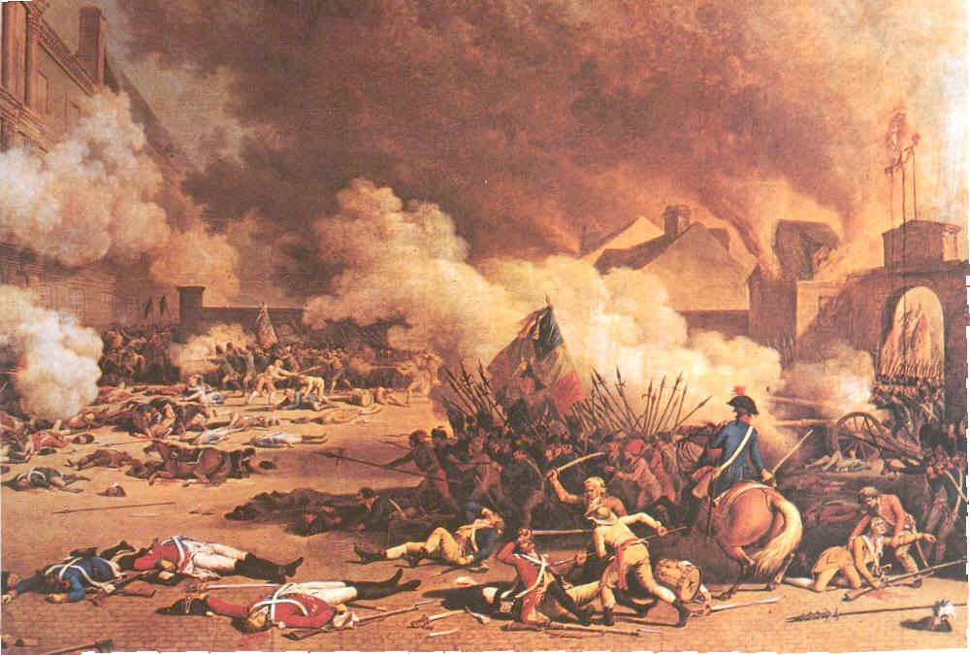
FROM BOURGEOISE REVOLUTIONS TO SOCIALIST REVOLUTIONS
ENGLISH, 1610
FRENCH, 1789 & U.S., 1776
EUROPE, 1848 [ARAB SPRING]
LATE 1800s “REVOLUTIONS FROM ABOVE (GERMANY, ITALY, JAPAN, [MEXICO]) TURKEY (“YOUNG TURKS”)
PARIS COMMUNE, 1871
BOLSHEVIK, 1917
ABORTIVE REVOLUTIONS IN GERMANY AND ITALY, 1919-1921, ELSEWHERE, SOUTH AMERICAN FERMENT, ETC
CHINESE, 1949
CUBAN, 1959
WORLD REVOLUTIONARY UPHEAVAL OF 1968
AFRICAN, CHILEAN, VIETNAMESE REVOLUTIONS,. AND OTHERS…
FRENCH REVOLUTON:
“LIBERTY, EQUALITY, FRATERNITY”

Slide 7
Is Marx and Marxism “Outdated”?
Global Capitalism in severe structural (systemic?) crisis and crisis of legitimacy/hegemony
Rebirth of Marxist and socialist thought – esp in light of crisis
Marx maligned in West during post-WWII period of capitalist prosperity – “his ideas were valid for early industrial revolution but outdated, e.g., immiseration, proletarianization”. Yet these all other theses have proved correct globally
Marxism marginalized in late 20th century post-modern interlude as “economic reductionism” or “European ideology”
Yet ever single social revolution in 20th century Marxist-inspired and socialist-oriented. Most vibrant revolutionary socialists from Latin America, Africa, Asia
My biography

Slide 8
Why revolutionary theory?
Lenin: ”There can be no revolution without revolutionary theory”
All knowledge based on experience, either direct or indirect: we cannot know the world without participating in efforts to change it;
Praxis = unity of theory and practice: all theory forged out of practice, and in turn informs practice: THE DIALECTIC OF LIVING HISTORY – Lenin: theory not a prescription - “concrete analysis of concrete situation”
Material reality forms our consciousness – and then consciousness acts back on material reality (relation between thought and practice) – HOW DOES OUR CONSCIOUSNESS DEVELOP?.... THROUGH EXPERIENCE AND REFLECTION
To study revolutionary theory we study revolutionaries who practiced revolution out of which emerged their theoretical reflections [Pithouse: “bringing struggle into theory”]
Cretien commenting on revolutionary theory of the state: “[revolutionary theory] marks the theoretical parameter; the whole art of politics consists in knowing how to operate on the field whose boundaries they mark”
Radical/revolutionary theory should be capable of inspiring emancipatory action; emancipatory action should regenerate revolutionary theory
Marx: critical/revolutionary theory = “the self-clarification of the struggles and wishes of the age”

Slide 9
BACKGROUND
Marx and Engels, French revolution, revolutions of 1848, Paris Commune 1871, rise of international workers/communist movement….from bourgeois revolutions to socialist revolutions
Bolshevik Revolution of 1917 – Lenin and Trotsky
Near revolution in Germany, Italy & elsewhere 1917-1923 – Luxemburg and Gramsci, voices from Latin America
Spanish Civil War – 1936-39
Immediate aftermath of WWII: revolutions in Hungary, Yugoslavia, nearly in Greece, France, Italy
After WWI: center of gravity of world revolutionary movement shifts to Third World. Politics of communism and socialist-oriented national liberation becomes dominant political framework for peoples of Third World (and still for workers in many First World Countries).
Chinese revolution of 1949
Cuban revolution of 1959
African anti-colonial struggle and national liberation struggles
1960s and 1970s: world revolutionary upheavals, culminating in 1968, national liberation struggle in Indochina
20th century closes with collapse of Soviet bloc, Third World revolutions, decline of Left worldwide, yet revolutionary uprising in Chiapas, Venezuelan revolution, and other revolutionary movements

Slide 10
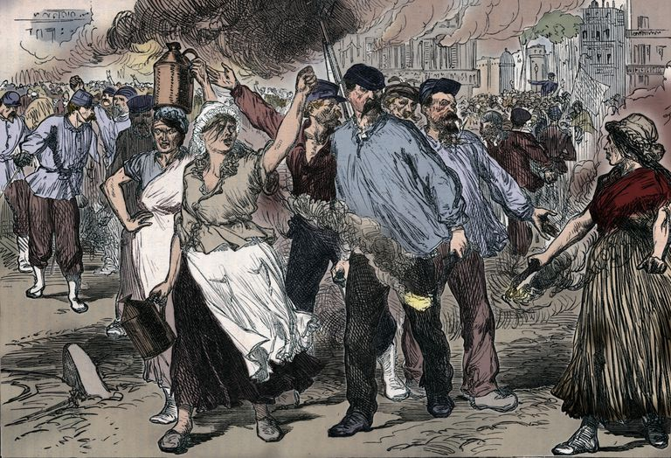
PARIS COMMUNE 1871: FIRST WORKER REVOLUTION

Slide 11
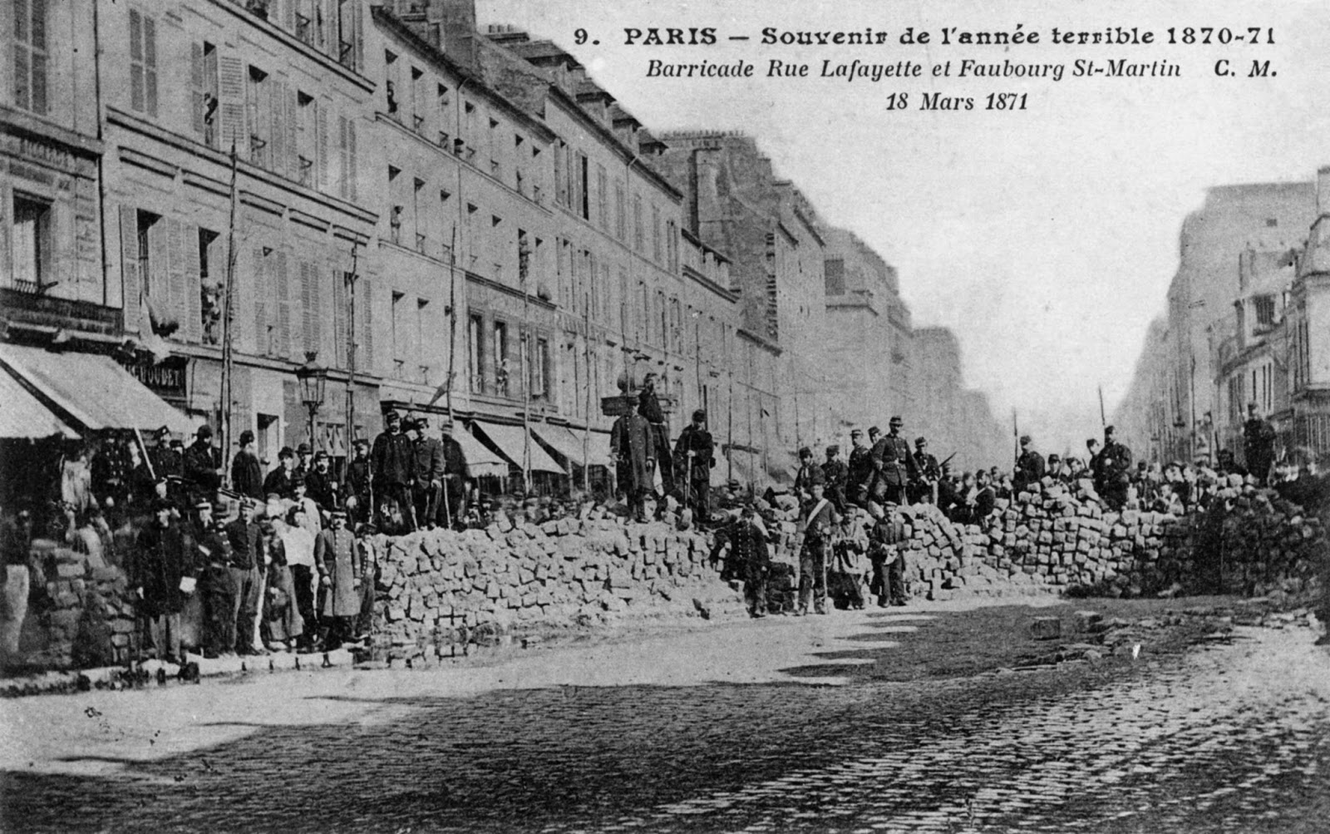

Slide 12
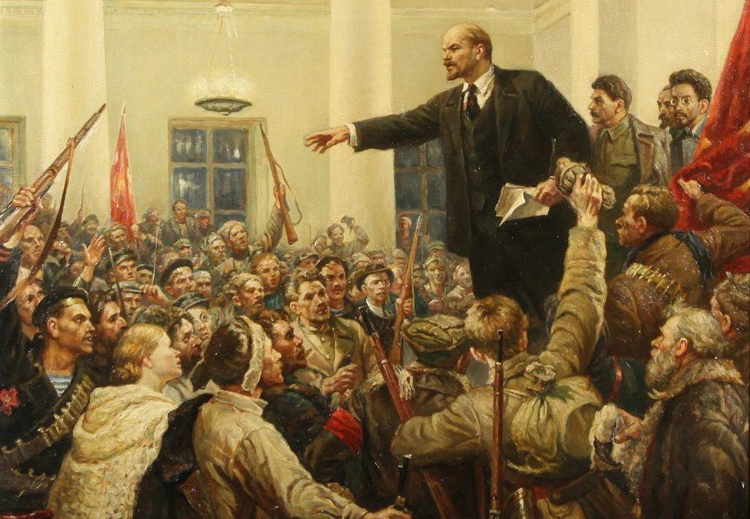
LENIN: LEADER OF BOLSHEVIK REVOLUTION

Slide 13
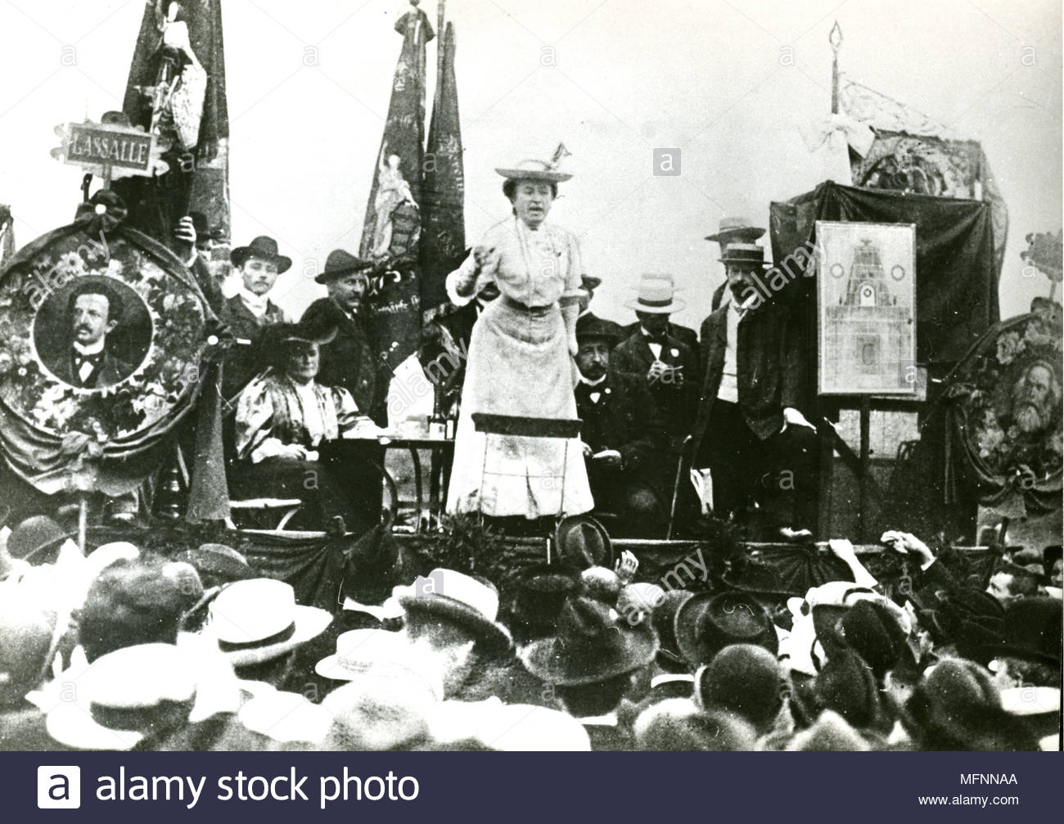
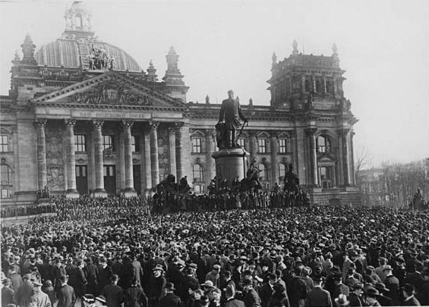
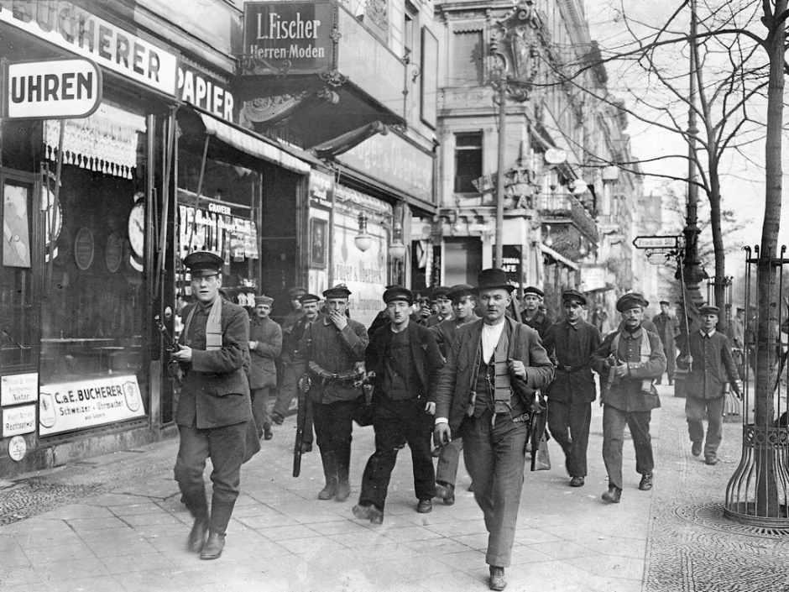
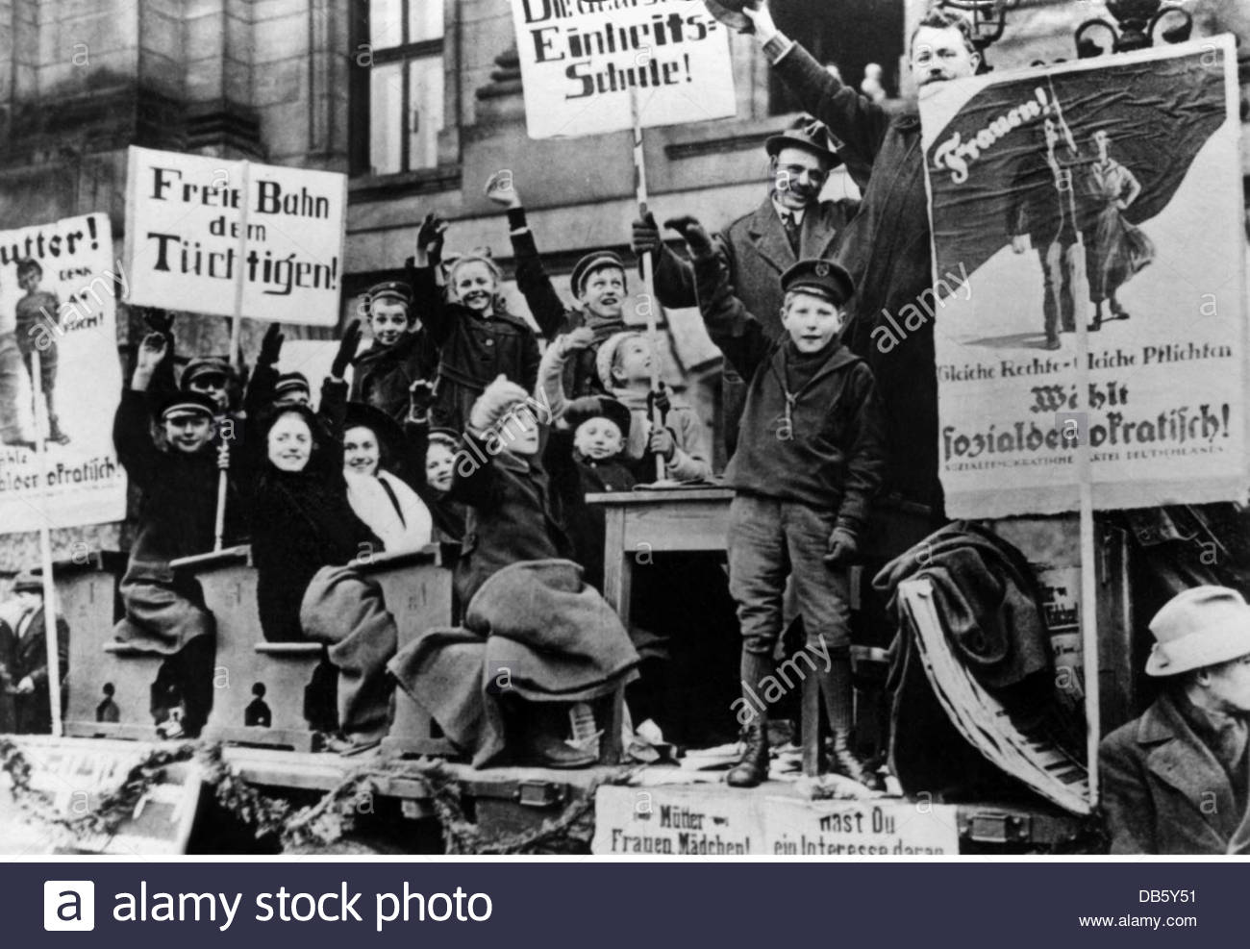
ROSA LUXEMBURG AND ABORTIVE GERMAN REVOLUTION OF 1918-1923

Slide 14
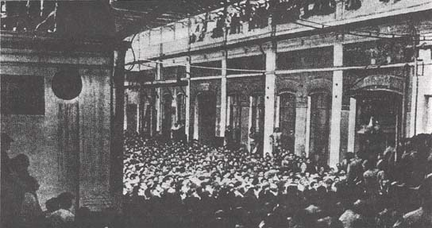
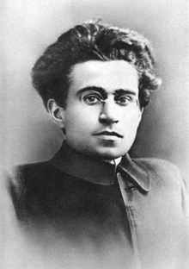
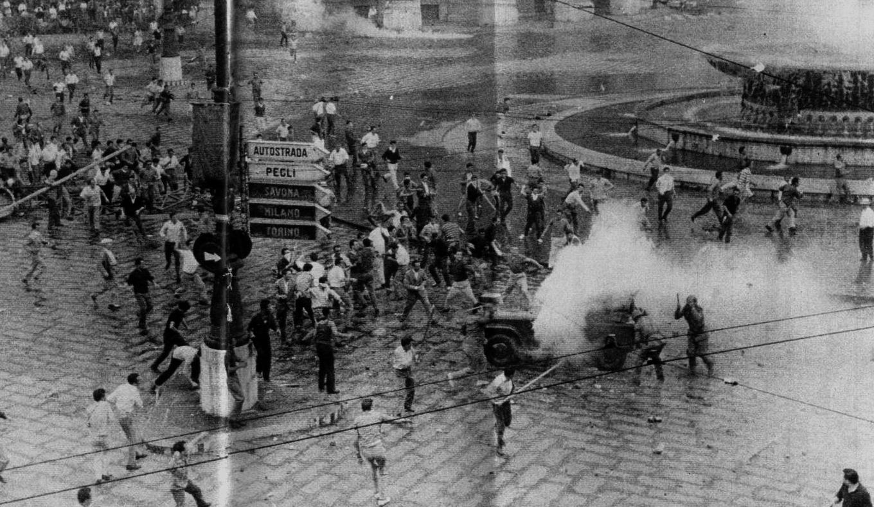
GRAMSCI AND THE TURIN WORKERS SOVIETS 1920

Slide 15

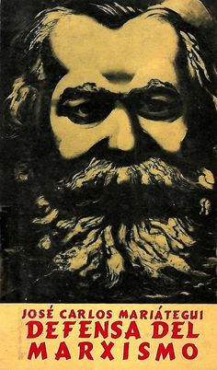
MARIATEGUI: MARXISM AND MODERN SOCIALIST STRUGGLE GROUNDED IN INDIGENOUS COMMUNISM

Slide 16
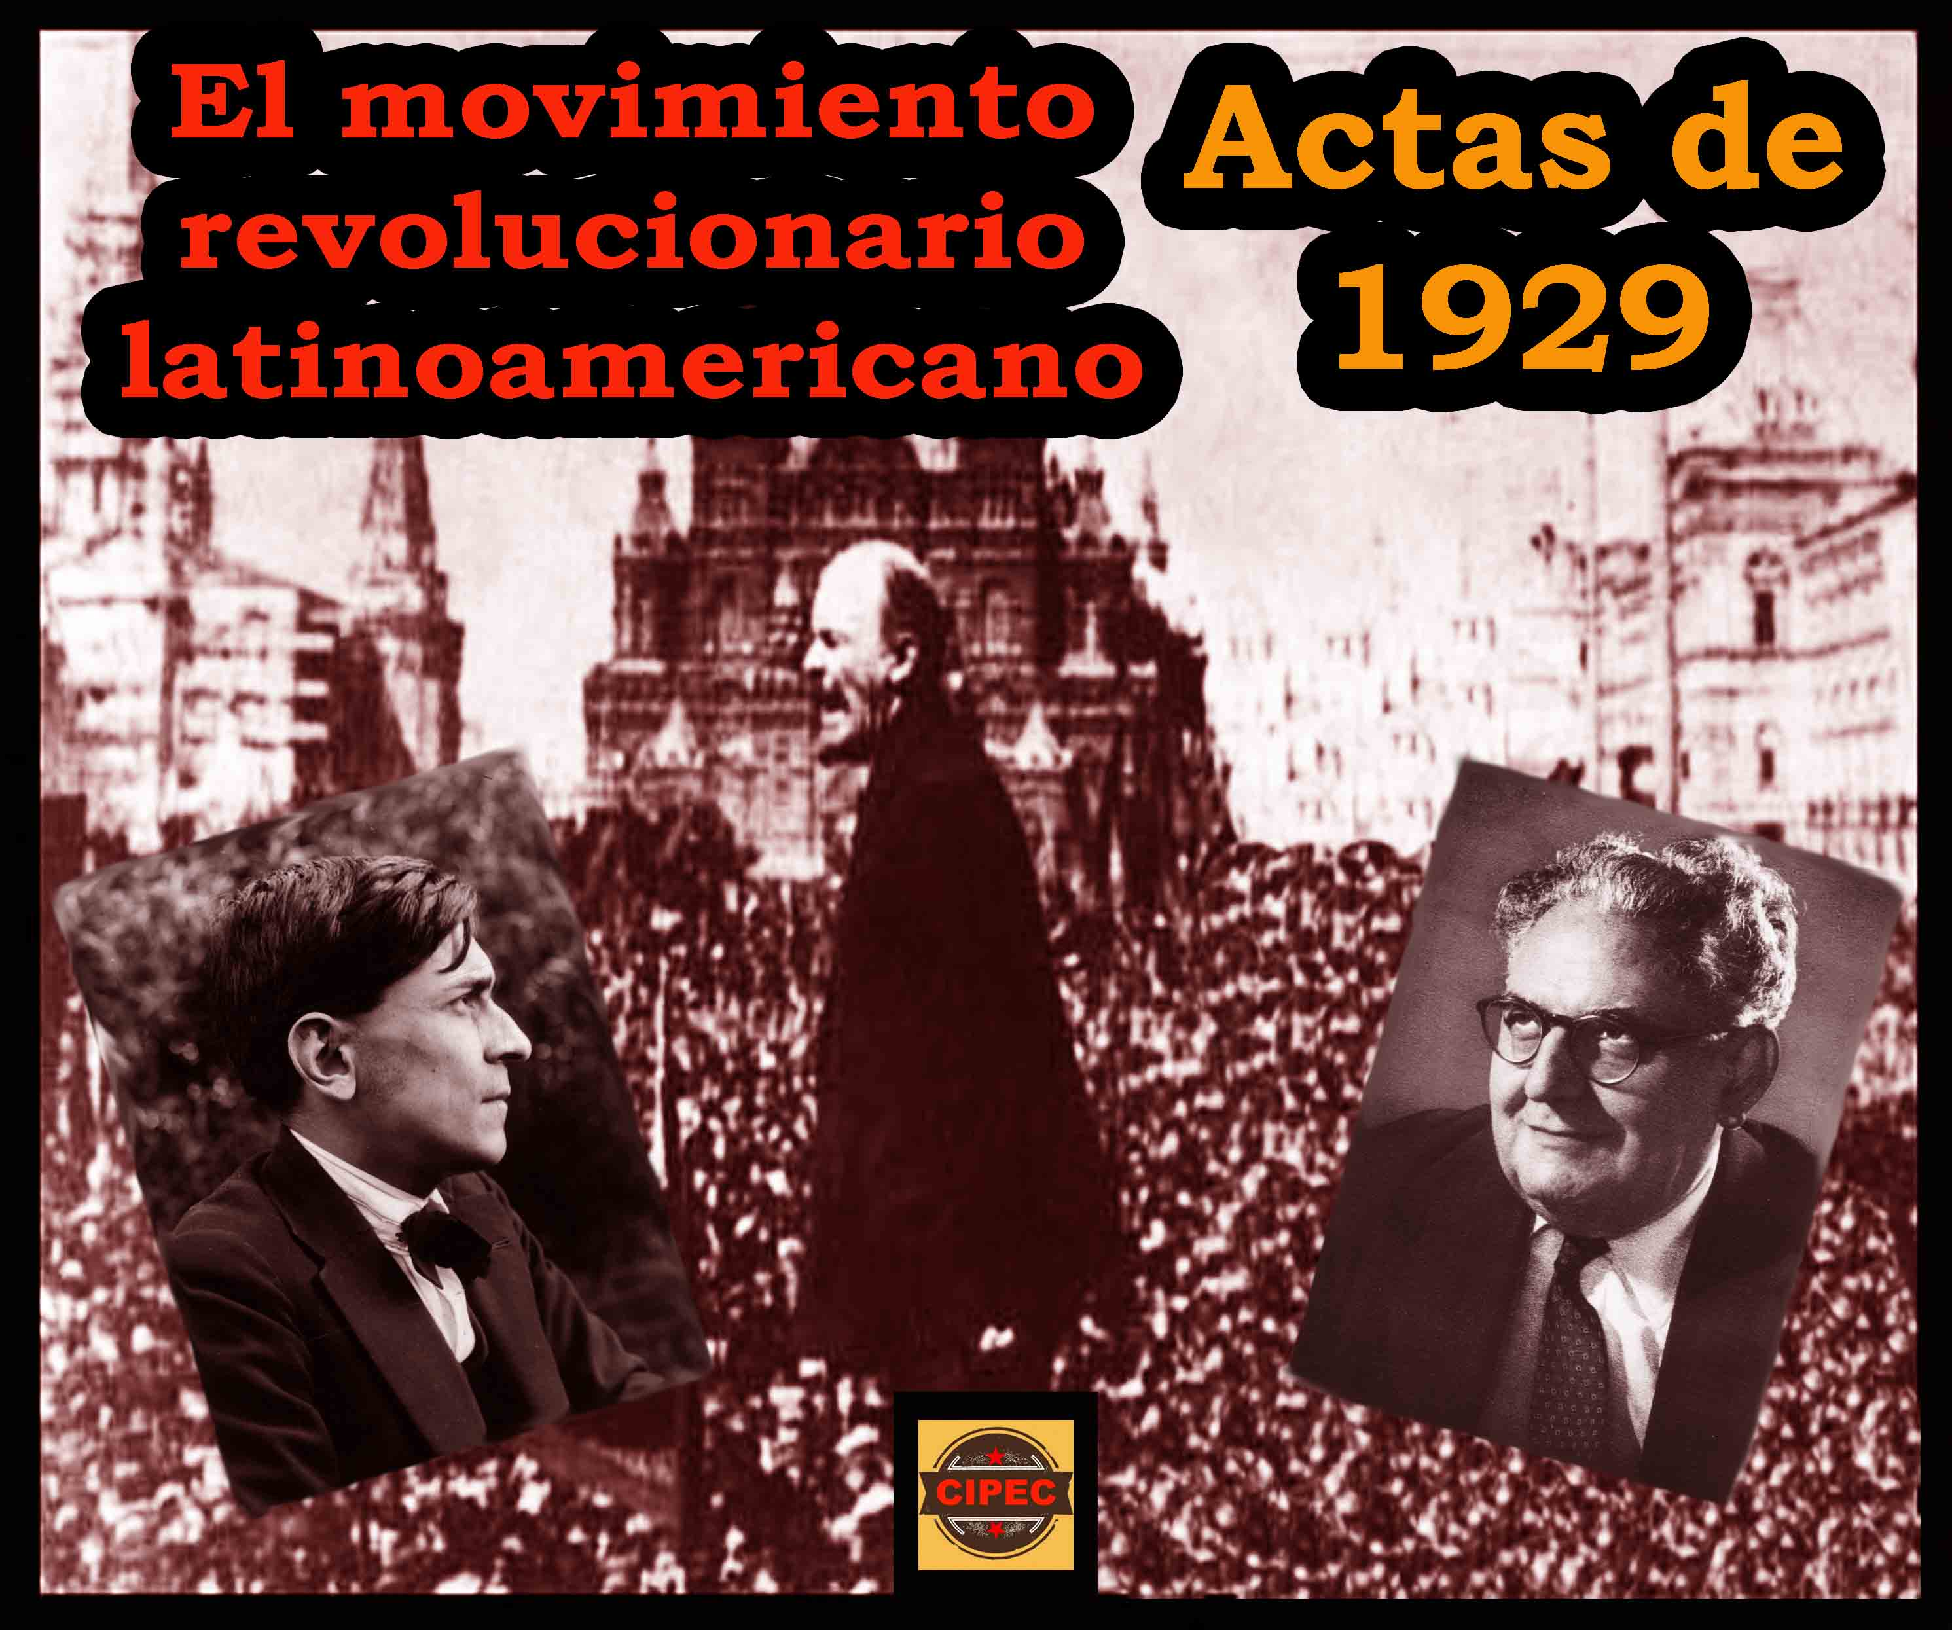
BOLSHEVIK REVOLUTION INSPIRES WAVE OF REVOLUTIONARY STRUGGLES WORLDWIDE, INCLUDING IN LATIN AMERICA. THESE AND LATER ONES IN LATIN AMERICA TAKE INSPIRATION FROM MARIATEGUI

Slide 17
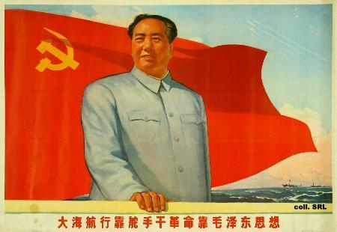
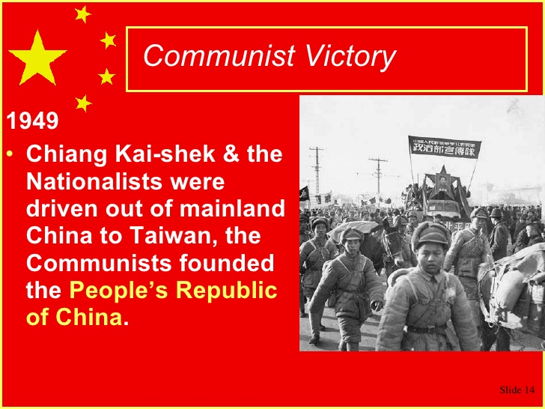
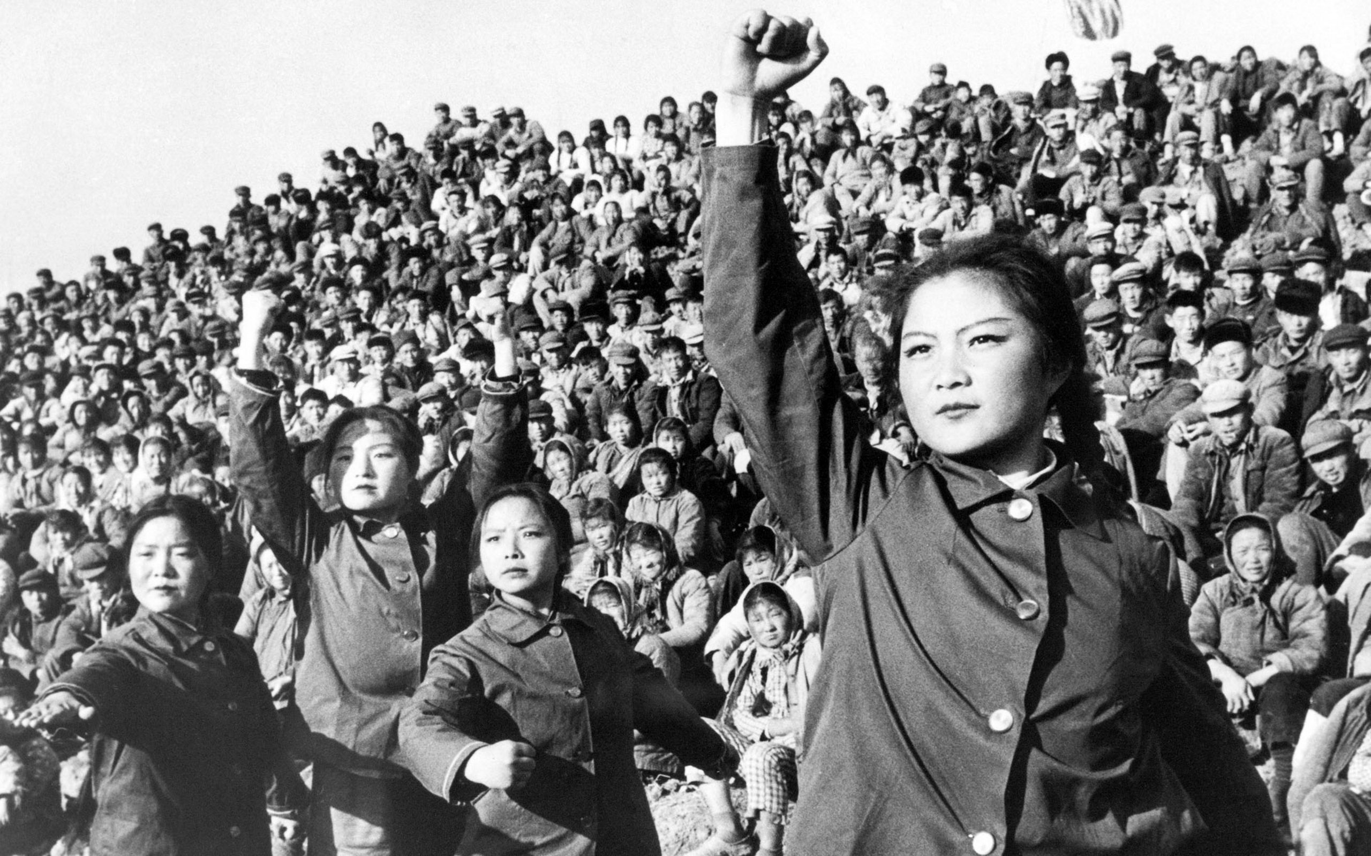
China: Peasant War of National Liberation

Slide 18
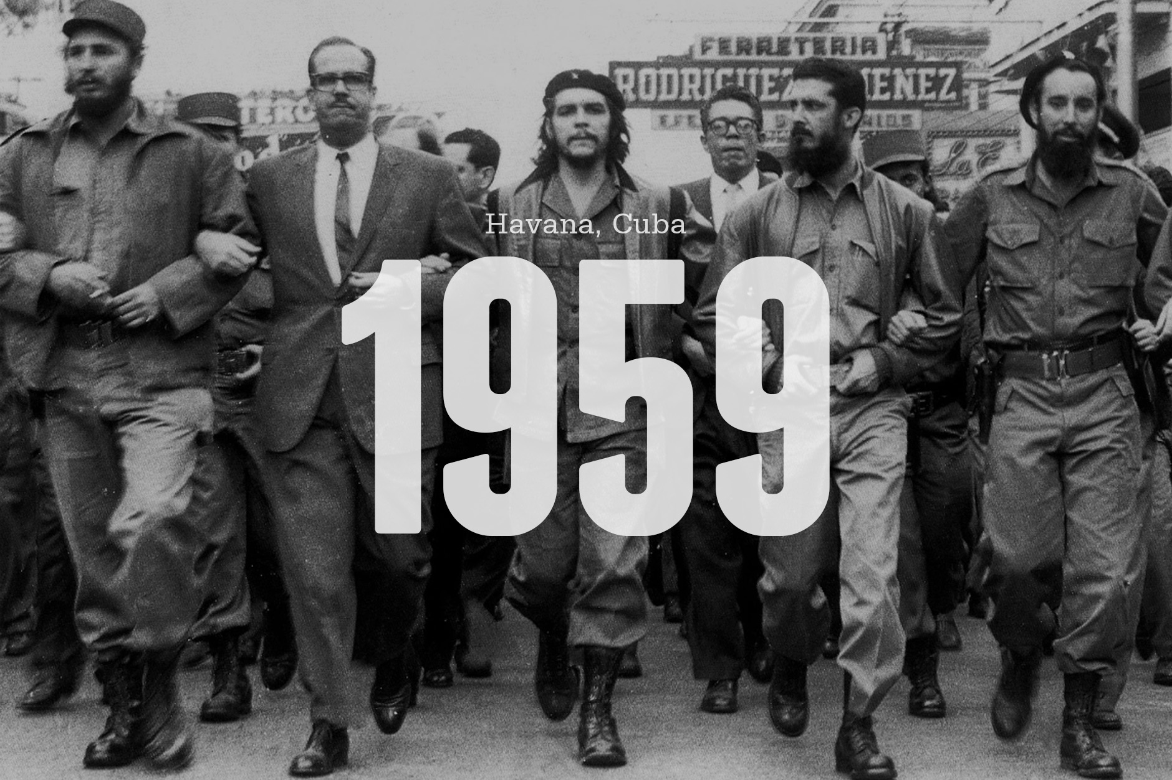
CHE GUEVERA, FIDEL CASTRO, AND THE CUBAN REVOLUTION

Slide 19
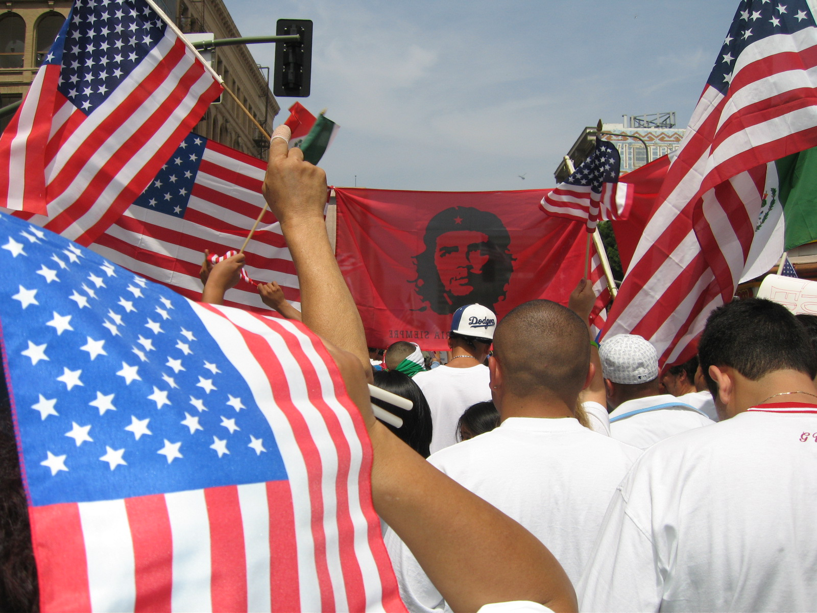
THE COUNTER-HEGEMONIC ALWAYS INFILTRATES THE HEGEMONIC

Slide 20
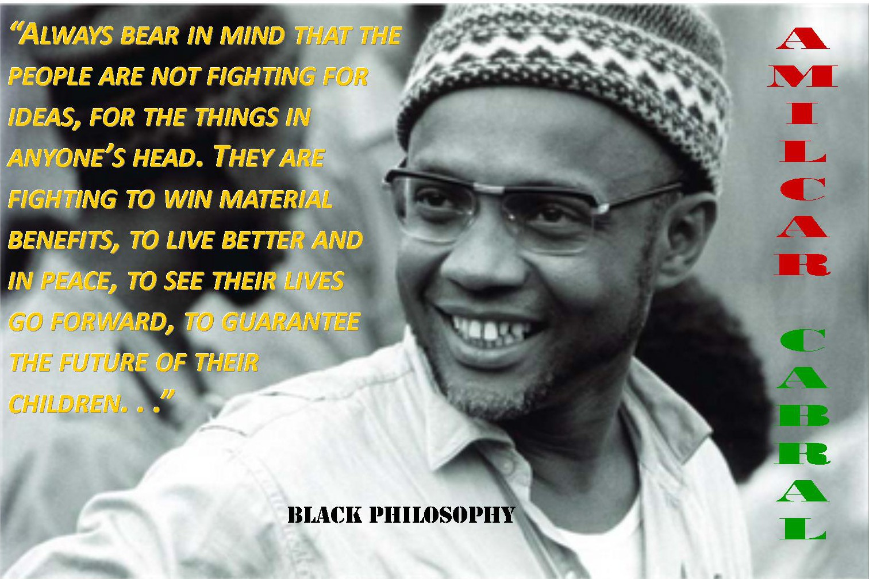
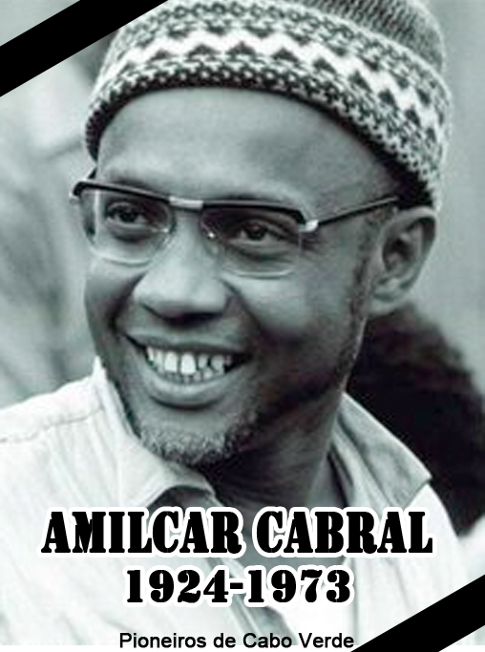
AMILCAR CABRAL: LEADER AND THEORETICIAN OF THE AFRICAN REVOLUTION

Slide 21
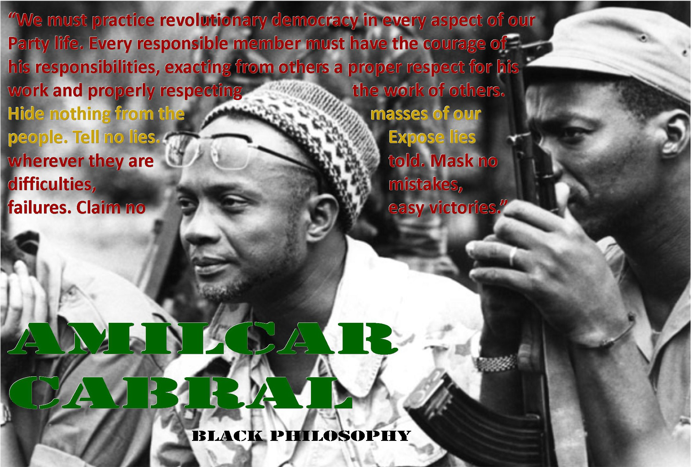

Slide 22
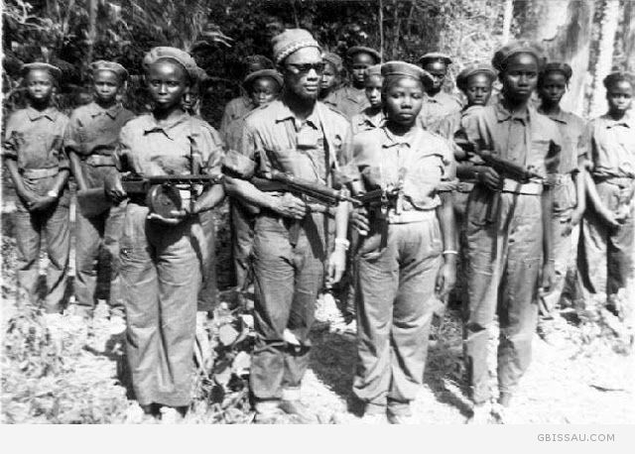
FOLLOWING CHINESE AND CUBAN REVOLUTIONS, THIRD WORLD NATIONAL LIBERATION STRUGGLES TAKE THE FORM OF GUERRILLA MOVEMENTS GUIDED BY REVOLUTONARY PARTY

Slide 23
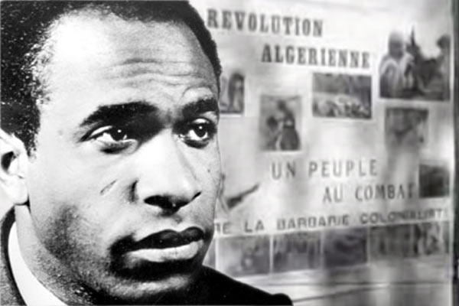
FRANZ FANON, THE AFRICAN REVOLUTIONS AGAINST COLONIALISM AND THE PETTY-/NATIONAL BOURGEOISIE

Slide 24
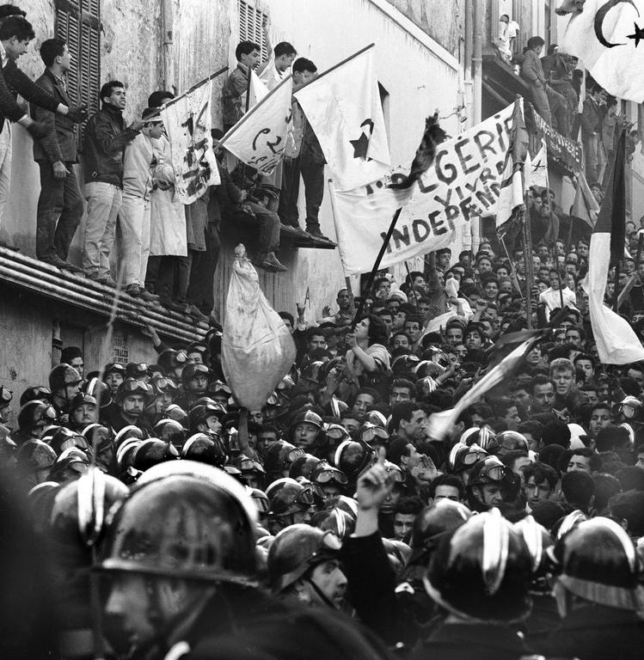
THE ALGERIAN ANTI-COLONIAL AND SOCIALIST-ORIENTED REVOLUTION: FANON FOUGHT IN THE ALGERIAN LIBERATION STRUGGLE

Slide 25
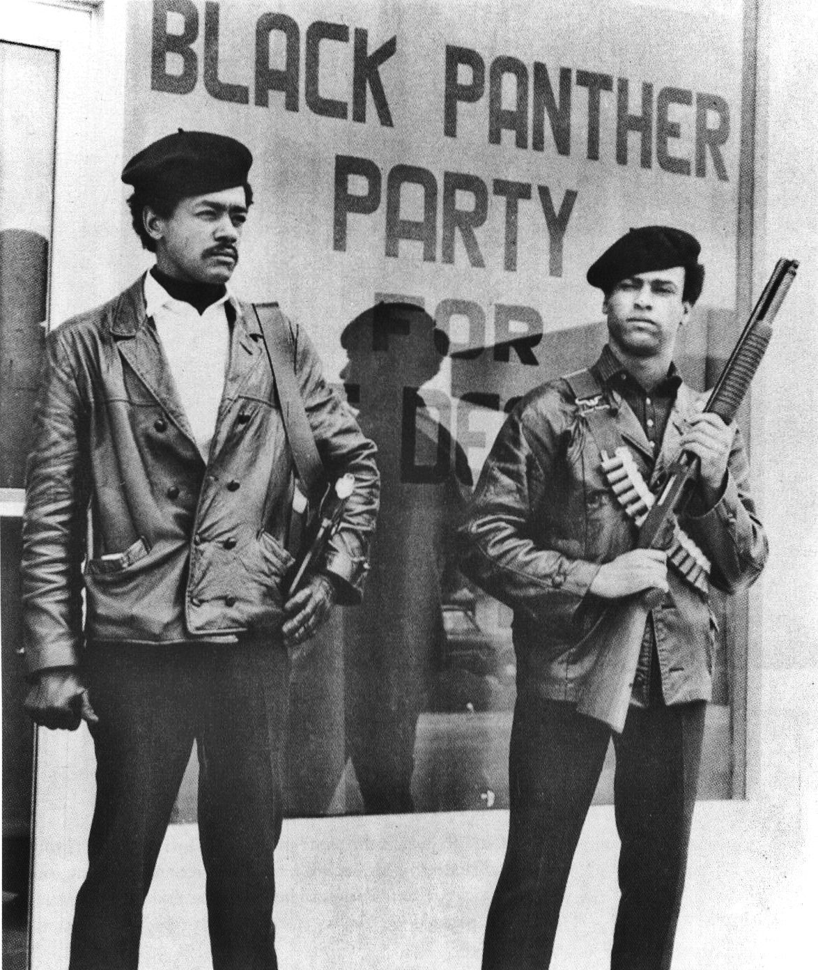
In the U.S. many in 1960s-70s began to connect racial & other forms of oppression and worker exploitation to a broader critique of capitalism Huey Newton: “Only by eliminating capitalism and substituting it for socialism will all black people be able to practice self-determination and thus achieve freedom” Combahee River Collective: “We realize that the liberation of all oppressed peoples necessitates the destruction of the political-economic system of capitalism and imperialism as well as patriarchy. We are in essential agreement with Marx’s theory….[but] we know that his analysis must be extended further in order for us to understand our specific economic situation as Black women”

Slide 26
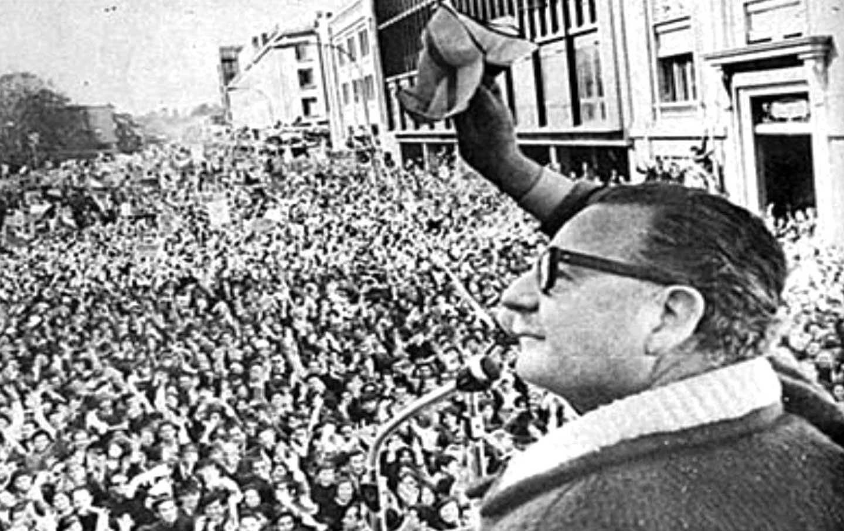
SALVADOR ALLENDE AND “THE REVOLUTION DISARMED” IN CHILE

Slide 27
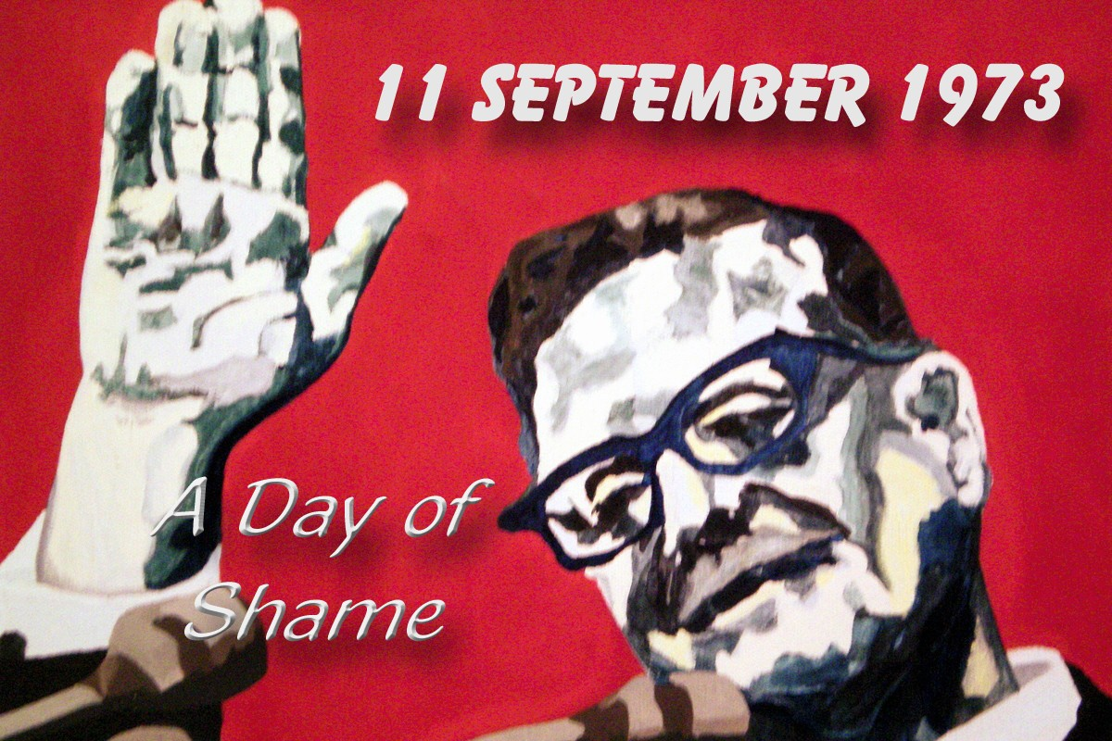
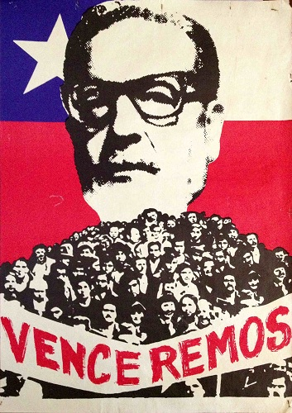
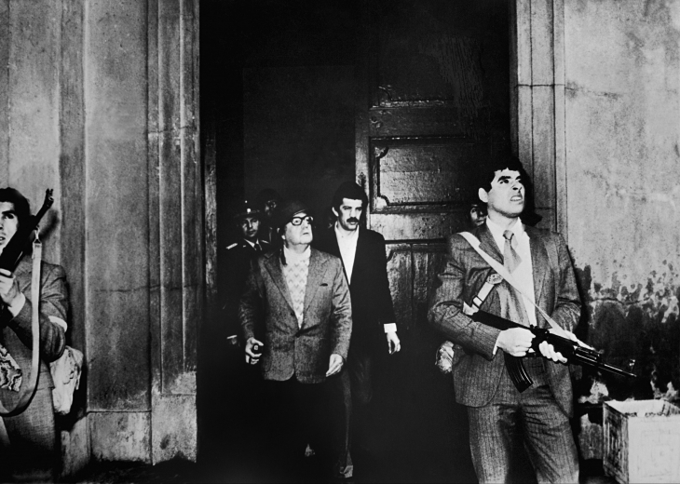
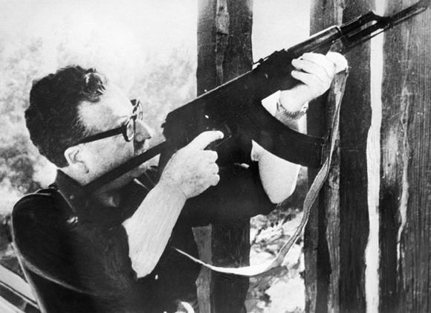
The First 9/11

Slide 28
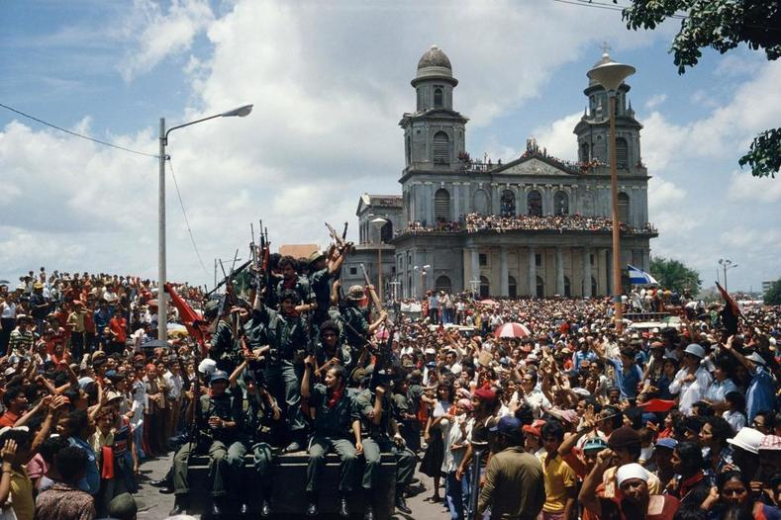
SANDINISTA REVOLUTION IN NICARAGUA 1979

Slide 29
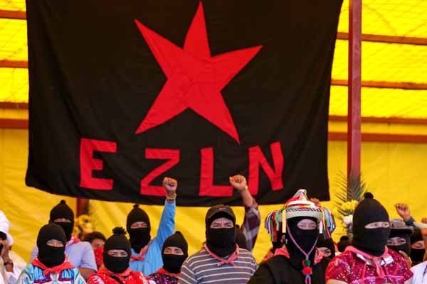
Zapitistas (Mexico): 1994 to date

Slide 30
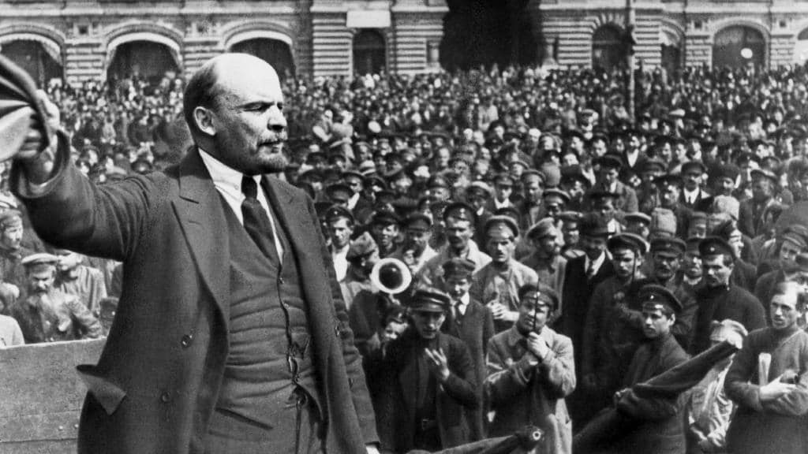
“REVOLUTIONS ARE FESTIVALS OF THE OPPRESSED AND THE EXPLOITED. AT NO OTHER TIME ARE THE MASSES OF THE PEOPLE IN A POSITION TO COME FORWARD SO ACTIVELY AS CREATORS OF A NEW SOCIAL ORDER AS AT A TIME OF REVOLUTION. AT SUCH TIMES THE PEOPLE ARE CAPABLE OF PERFORMING MIRACLES” - V.I. LENIN

Slide 31


